Slide 1




Project:
Hospital Management System
Faculty:
Miss Fareeha Jabeen
By:
Syed Shiraz Haider & Ahmed Irfan

Slide 2
Table of Contents
Introduction to HMS
HMS Project Overview
Technologies Used
Database Design
Flow Chart
System requirements
Installation guide

Slide 3

Introduction to HMS
A Hospital Management System (HMS) is a computer-based system designed to manage and streamline various administrative, operational, and clinical tasks within a healthcare institution, such as hospitals, clinics, and medical centers. The system integrates various modules and functionalities to automate processes, enhance efficiency, improve patient care, and assist in decision-making for healthcare providers and administrators.

Slide 4
HMS Project Overview
Our Hospital Management System (HMS) is comprised of three core modules: the Admin Module, Doctor Module, and Patient Module. These modules are designed to streamline and enhance the functioning of our healthcare institution. Here's an overview of each module's functionalities:
Our Hospital Management System strives to create an integrated platform that enhances communication, streamlines processes, and promotes efficient healthcare management for all stakeholders—admin, doctors, and patients. Through these modules, we aim to provide a comprehensive solution that caters to the needs of a modern healthcare institution.
HMS Modules
Admin
Doctor
Patient

Slide 5
Admin
The Admin Module is the central hub of the HMS, where administrative tasks are managed efficiently.
The admin has the privilege to view and manage all administrative accounts within the system. This includes adding and removing admin accounts.
Admins can update their own profiles to ensure accurate and up-to-date information.
A comprehensive view of all doctors within the institution is available to the admin. They can also oversee the recruitment process, viewing job requests from potential doctors.
Job requests from doctors can be reviewed by the admin, who has the authority to approve or reject them.
Admins can adjust and update doctors' salaries based on administrative decisions and requirements.
Patient records are accessible to the admin, providing insights into the total number of patients and their details.
The admin can monitor and address reports and complaints submitted by patients, ensuring the highest quality of care.
The financial aspect of the hospital is managed through the admin module, with the ability to view and analyze total invoices.

Slide 6
The Doctor Module empowers medical professionals with tools to manage patient care effectively.
Doctors can update their profiles, keeping their information current for accurate communication.
Appointment management is streamlined, enabling doctors to view upcoming appointments and schedule their time efficiently.
Invoicing functionalities are available to doctors, allowing them to create invoices for services rendered.
Patient checkups and consultations are facilitated through the system, with options to prescribe medications and treatments.
Doctors can access patient records and details, ensuring a holistic view of patient health.
Doctor

Slide 7
Patient
The Patient Module is designed to enhance the patient experience and engagement with the hospital.
Patients can book appointments by providing symptoms and preferred dates, making the scheduling process seamless.
A reporting system allows patients to communicate concerns or submit reports to the admin for prompt attention.
Patients can engage with their healthcare journey by accessing their medical records and treatment history.

Slide 8







Technologies Used
As Our Project full stack functionality app so we have used frontend+backend technologies.
Front End
Back End

Slide 9
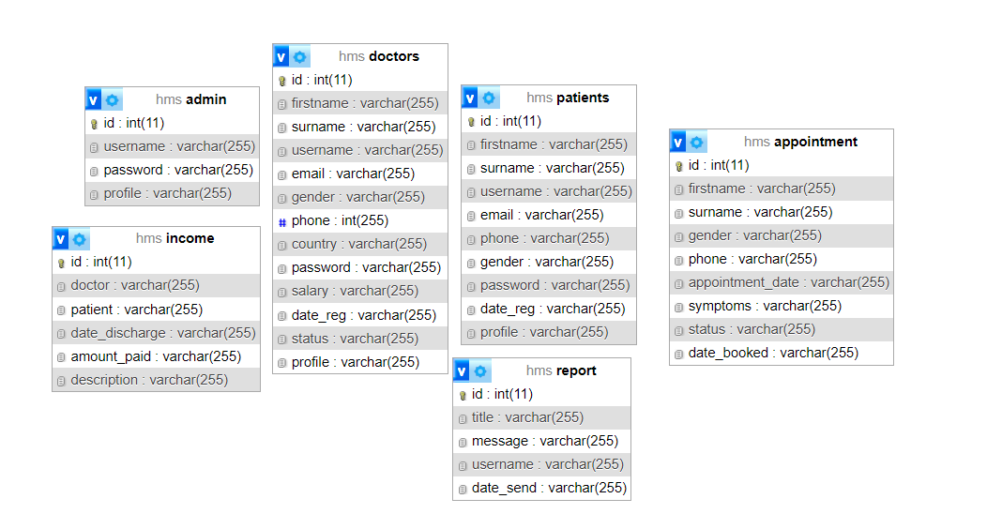
Database Design
This is our HMS Website Database.

Slide 10


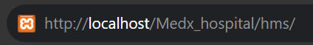

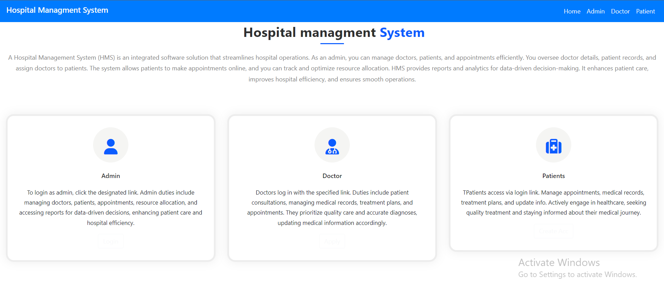


Flow Chart
Our Hospital website to HMS redirection
This link would redirect to our Medx hospital website
OR
Medx website to HMS links are
Redirected to HMS successfully
Note: The Medx_hospital ui webpage is not main part of the project it was used for the beautification but still its somehow dynamic.

Slide 11
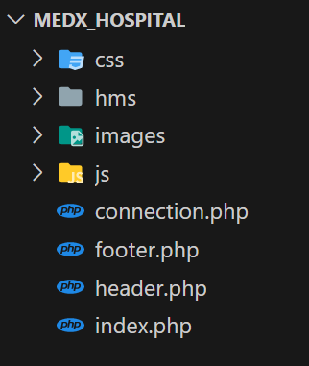
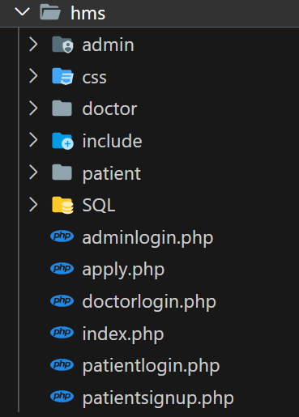
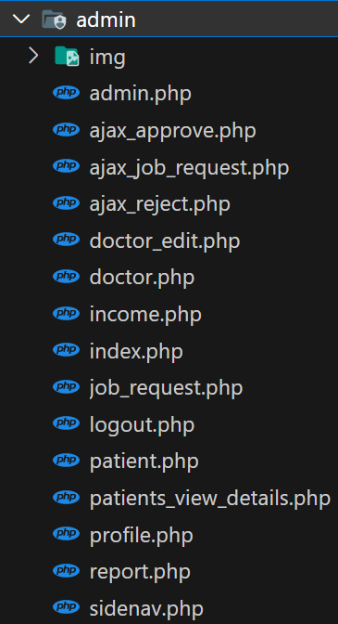
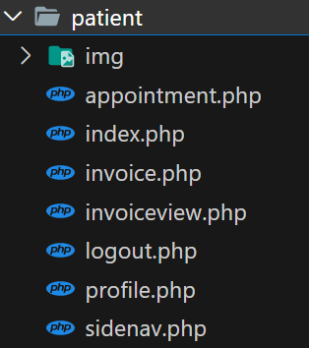
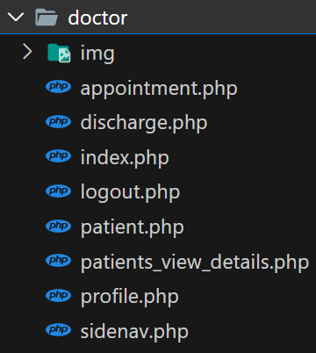
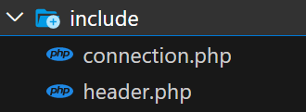
Our Hospital Management System File Structure
Inside Medx subfolder hms
Inside hms subfolder admin
Inside hms subfolder patient
Inside hms subfolder doctor
Medx_hospital file
Inside hms/include folder
connection.php and header.php is used up by

Slide 12
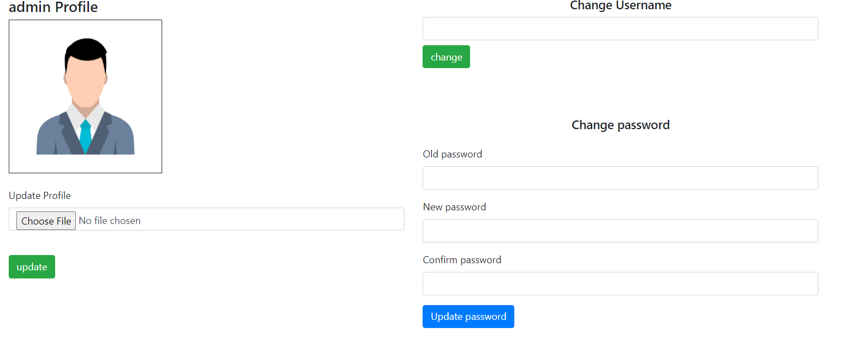
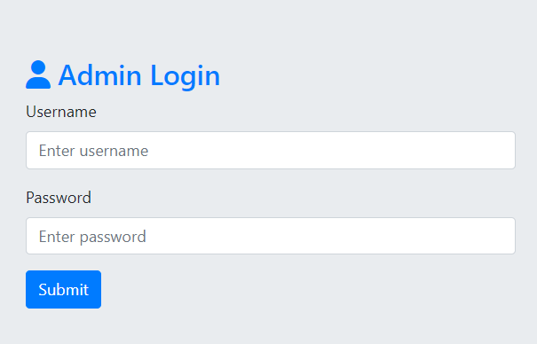
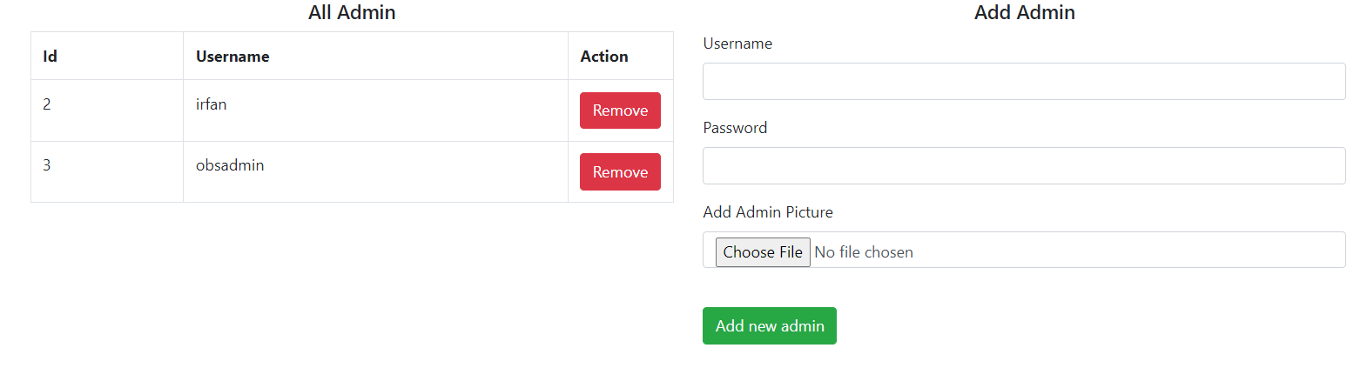
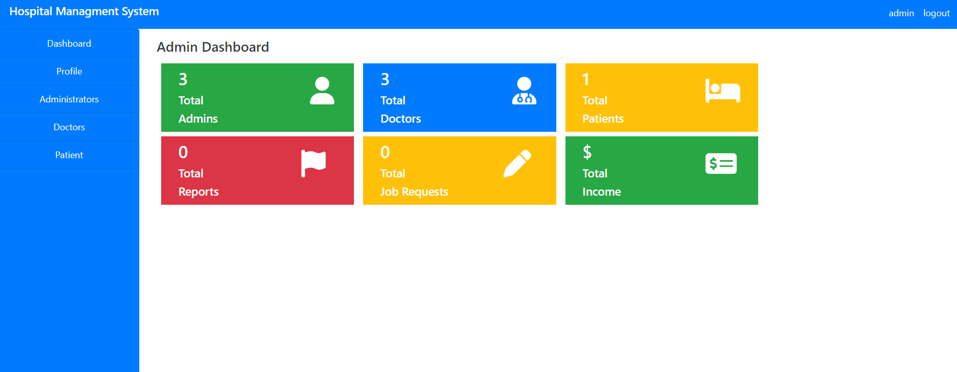
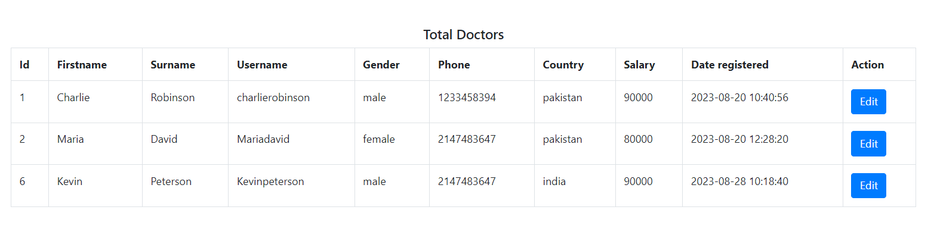
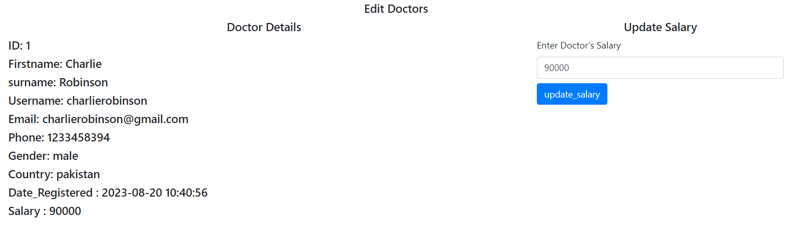
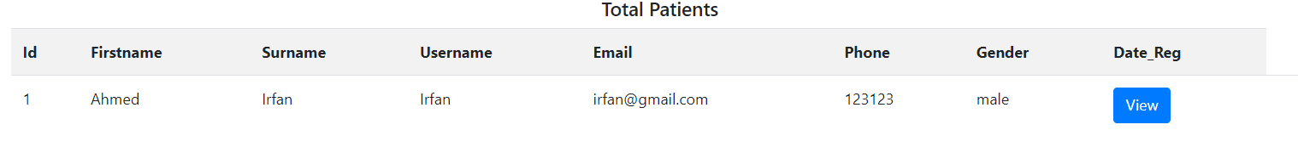
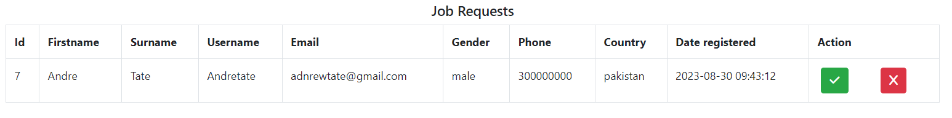

Admin, doctor And Patient Functionality
Admin’s Perspective
Update his profile
Add or delete admin
Admin can do perform these
See all doctors
See individual Dr info and update his salary
After admin login Redirected to Admin Dashboard
See all patients
Approve or Reject Dr’s job request
See total income

Slide 13
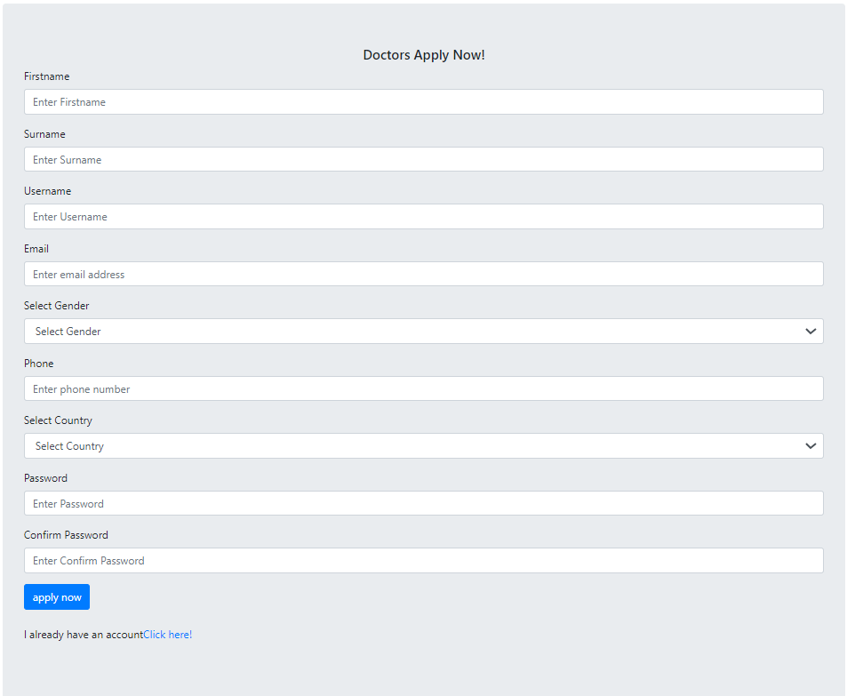
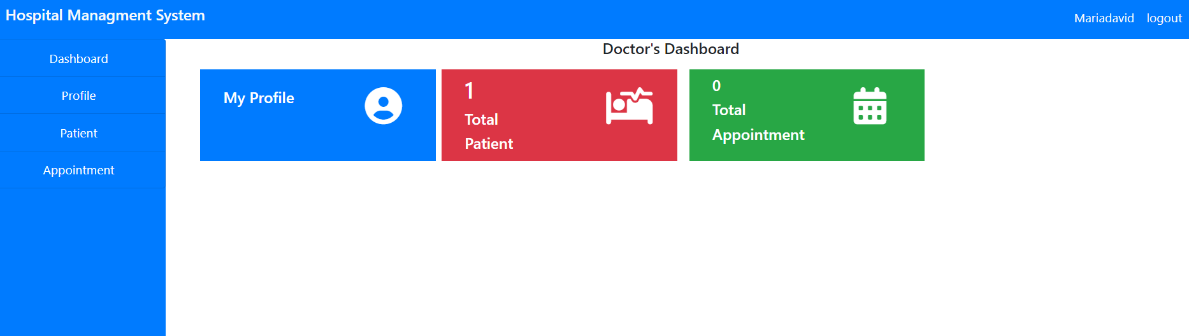
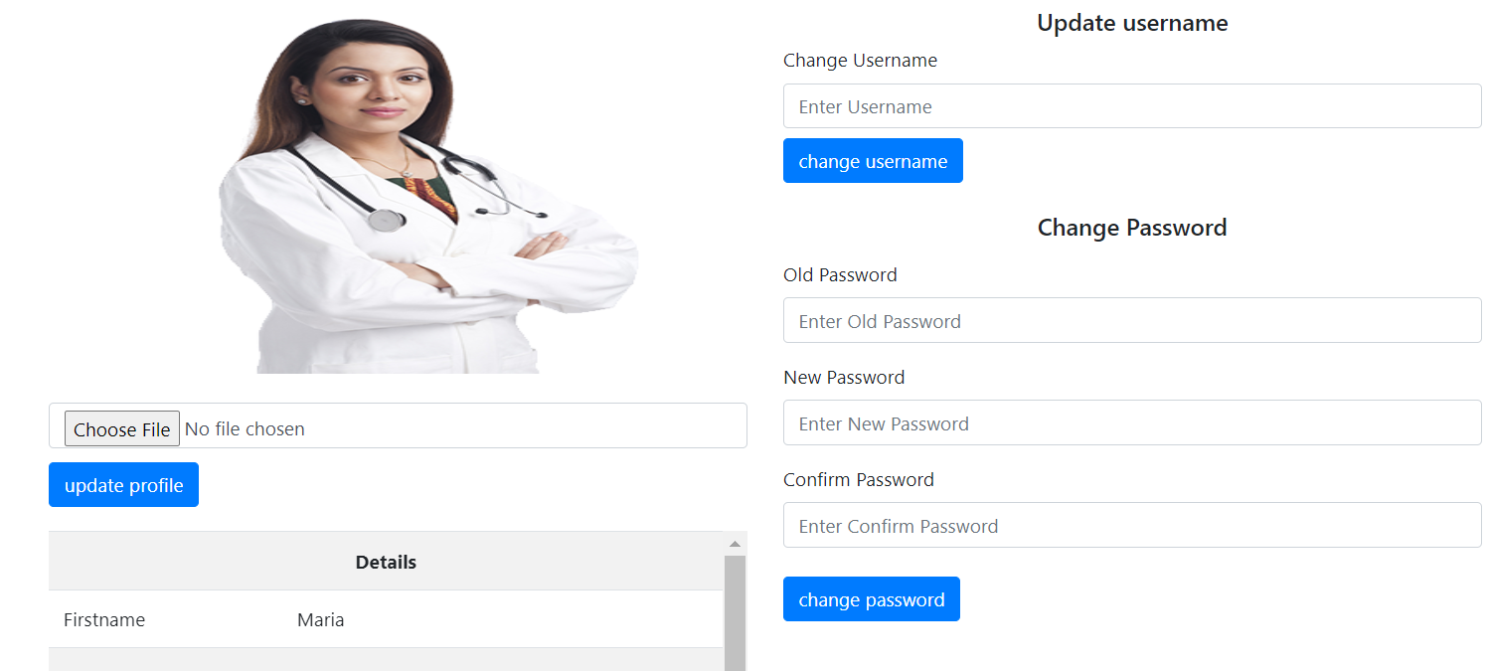
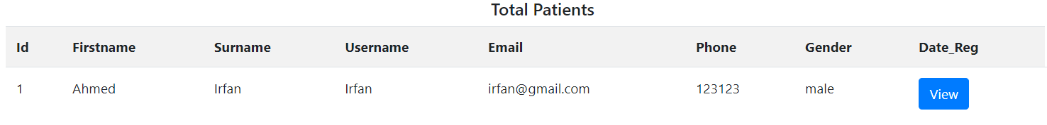
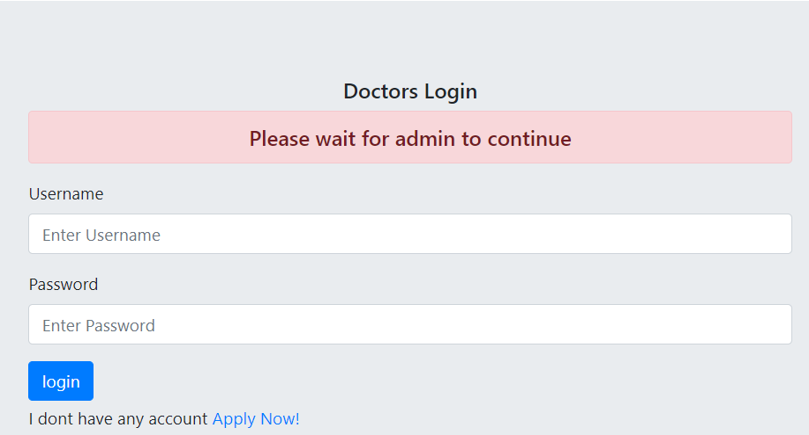
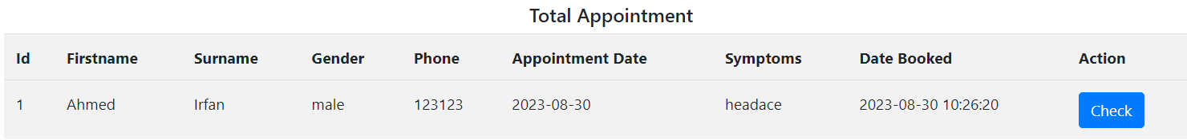
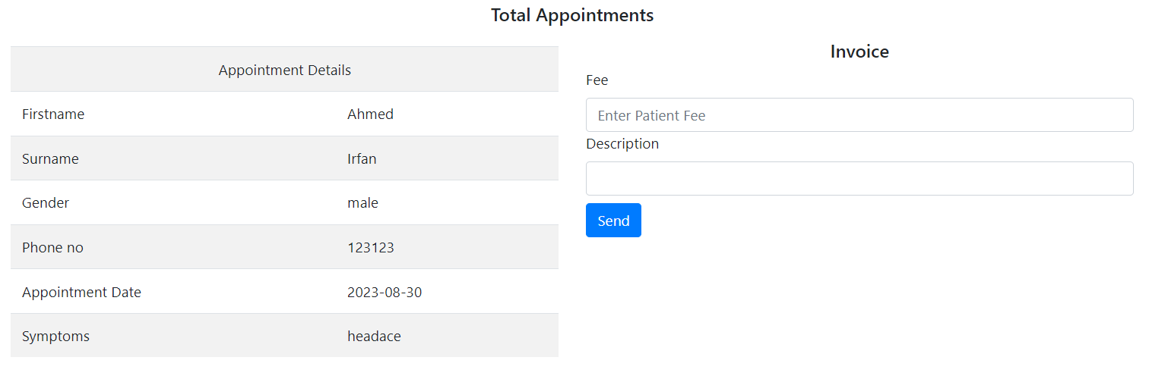
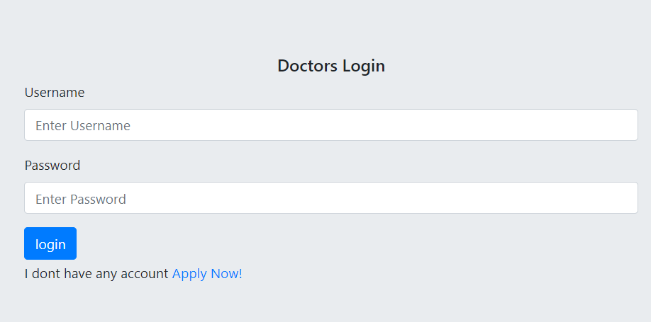
Doctor's Perspective
Redirected to doctor’s dashboard
Update his/her profile
Doctors Apply Form
Doctor can do perform these
See total patients
See total appointments
Cant login until admin approves job request
See appointment details make invoice and give prescription to patient
Can login when admin approves job request

Slide 14
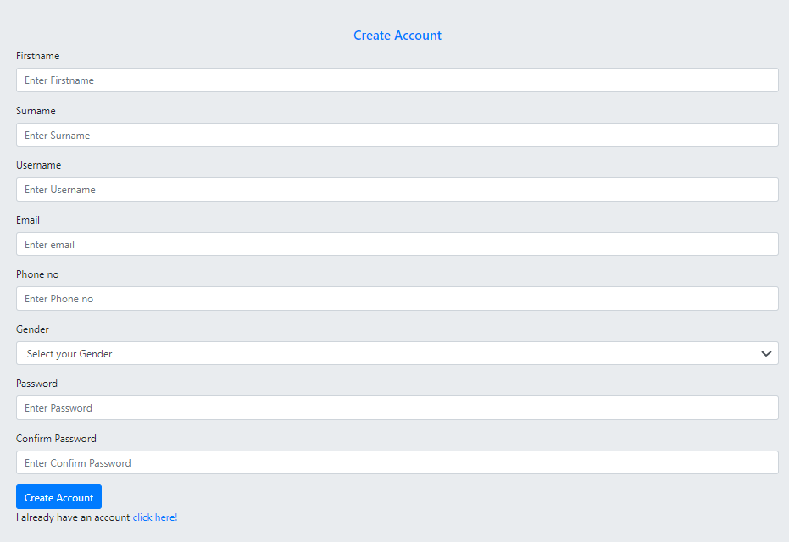
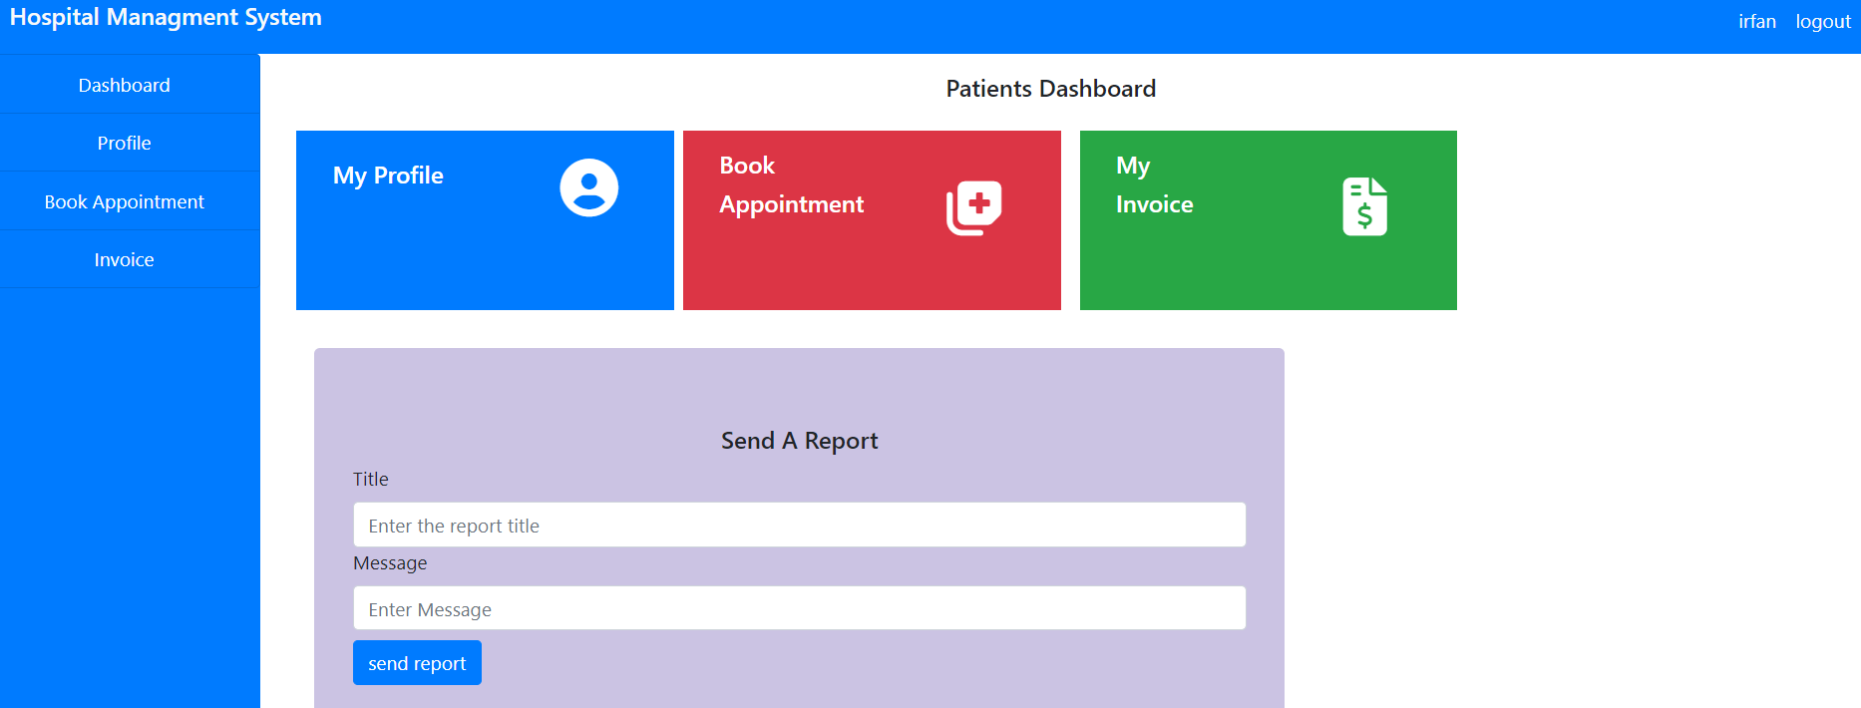
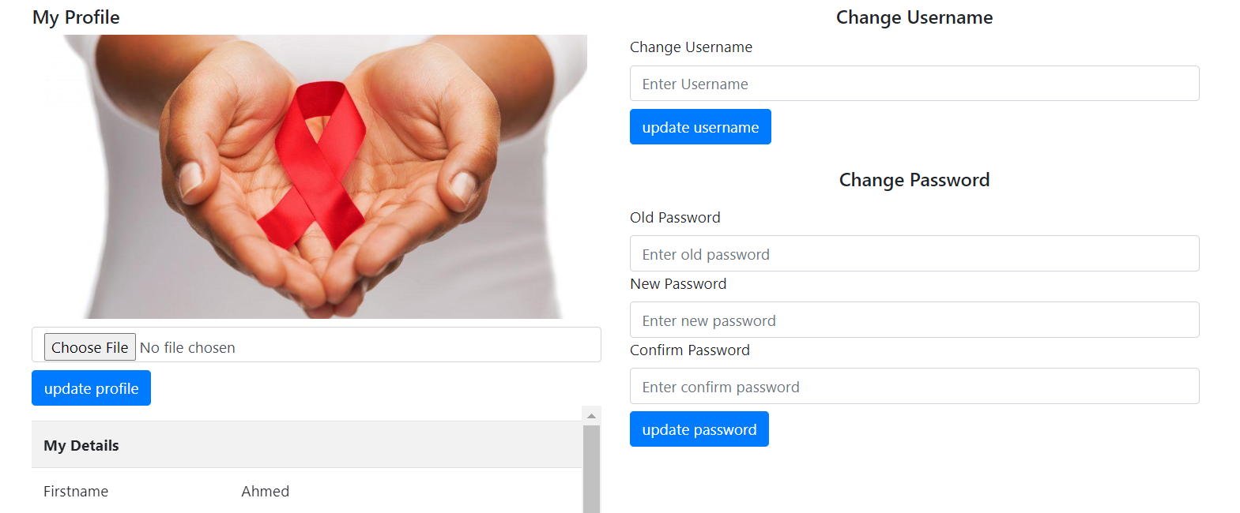
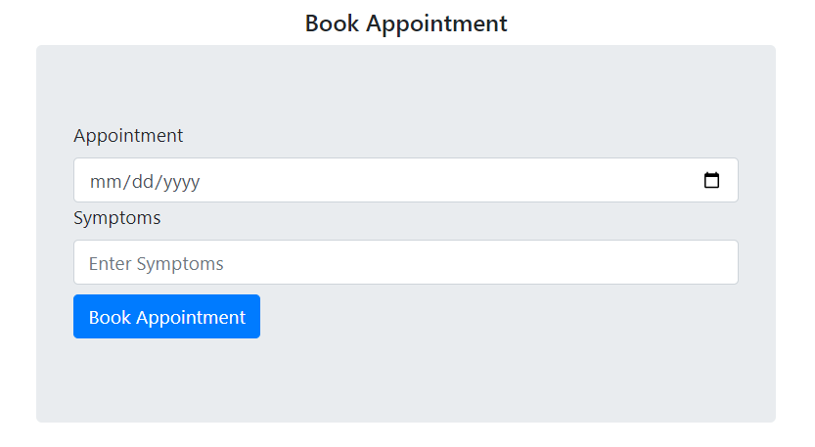
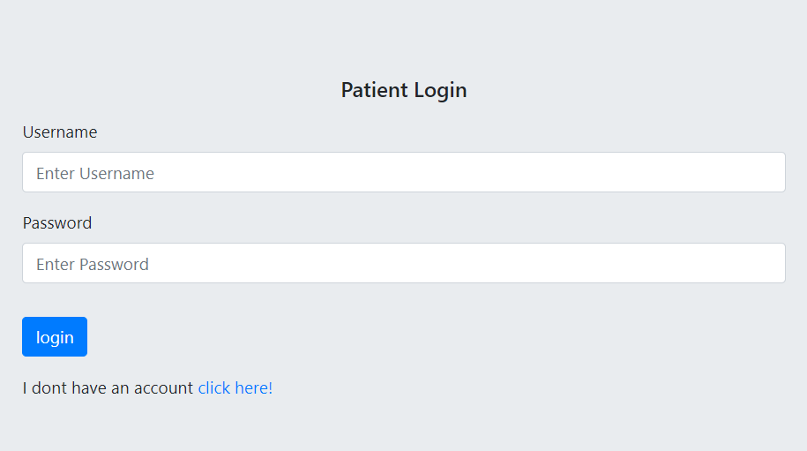
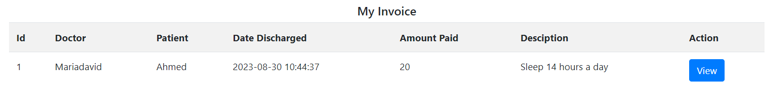
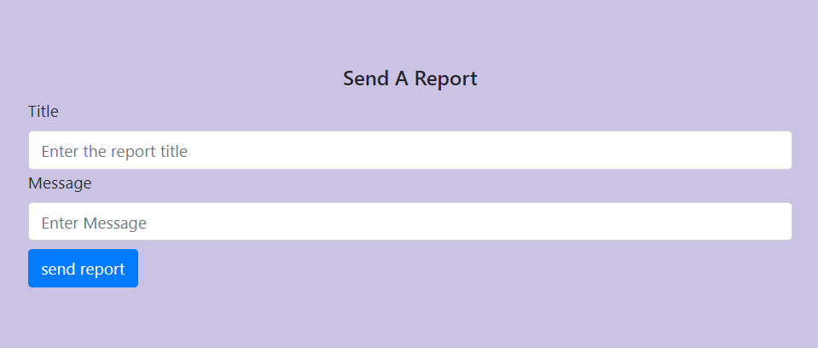
Patient's Perspective
Redirected to patient’s dashboard
Update his/her profile
Patient can do perform these
Patient's Registration Form
Book appointment by providing symptoms
See invoices
Patient's Login Form
Send report/complain to admin

Slide 15
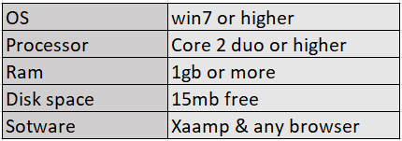

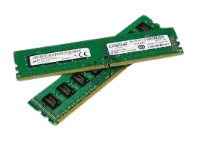




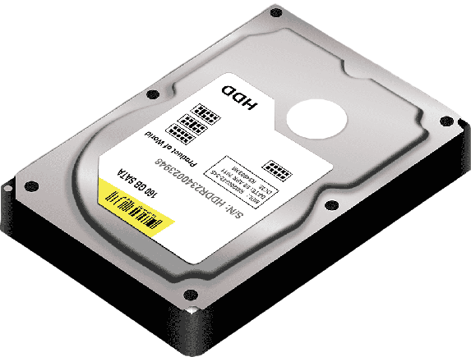
System Requirements
In order to run this project the requirements are provided below

Slide 16
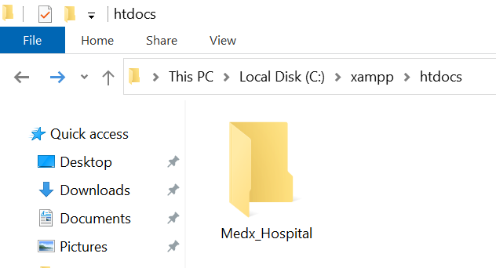
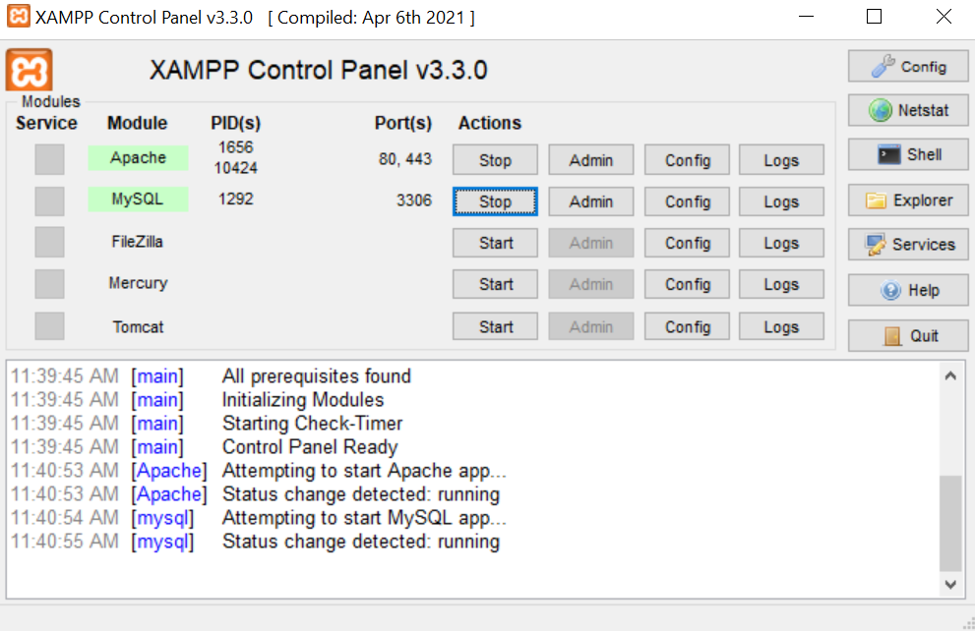
Installation Guide
Step1)Download and install Xaamp in C drive partition
https://www.youtube.com/watch?v=DaJd6cM09po
Step2)Select MEDX_HOSPITAL website cut it an paste in C:\xampp\htdocs
Step3)Open Xaamp and start Apache and MySQL server

Slide 17
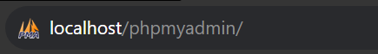
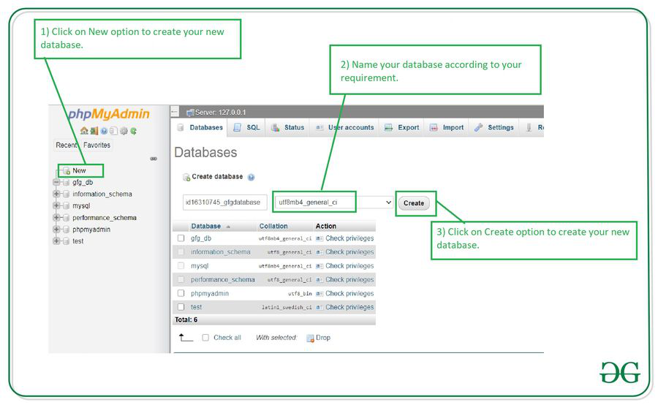
Step4)Then open any web browser on pc laptop and search
localhost/phpmyadmin
Step5)Then create a new database named hms

Slide 18
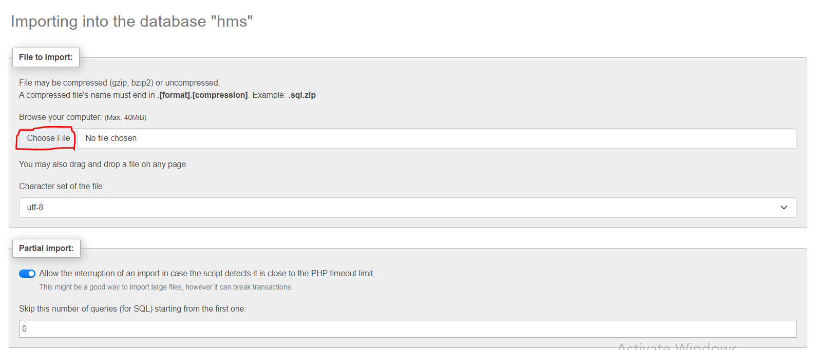
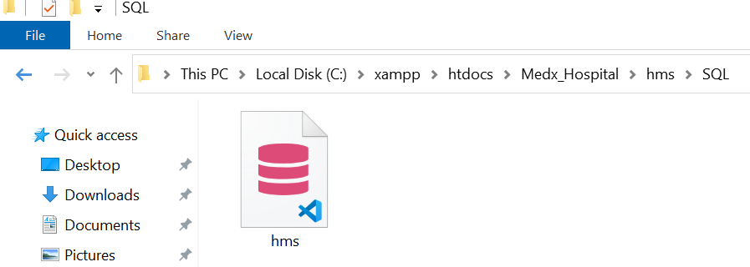
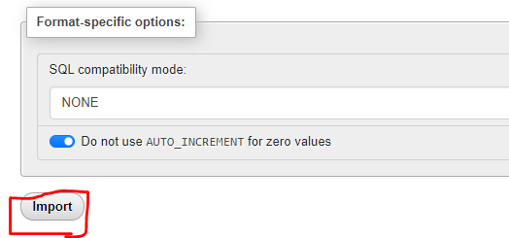
Step6)Now select hms from sidebar and then click on import option and top
Step7)Then select sql file from MEDX_HOSPITAL/hms/SQL/hms.sql
Then click on import
Step8)Open another tab in browser and type this link and you're ready to go
localhost/MEDX_HOSPITAL OR localhost/MEDX_HOSPITAL/hms

